Slide 1
POWER SYSTEM ANALYSIS AND DESIGN EE-501
Dr. Wazir Muhammad
Electrical Engineering Department
BUET, Khuzdar

Slide 2
First Week | Introduction, Phasors, Instantaneous Power in Single-Phase AC Circuits, Complex Power, Network Equations, Balanced Three-Phase Circuits, Power in Balanced Three-Phase Circuits , Advantages of Balanced Three-Phase Versus Single-Phase Systems.
Second Week | Power Transformers, The Ideal Transformer, Equivalent Circuits for Practical Transformers, The Per-Unit System, Three-Phase Transformer Connections and Phase Shift, Per-Unit Equivalent Circuits of Balanced Three-Phase Two-Winding Transformers, Three-Winding Transformers, Autotransformers, Transformers with OFF-Nominal Turns Ratios.
Third Week | Transmission Line Parameters, Transmission Line Design Considerations, Resistance, Conductance, Inductance: Solid Cylindrical Conductor, Inductance: Single-Phase Two-Wire Line and Three-Phase Three-Wire Line with Equal Phase Spacing, Inductance: Composite Conductors, Unequal Phase Spacing, Bundled Conductors, Series Impedances: Three-Phase Line with Neutral Conductors and Earth Return, Electric Field and Voltage: Solid Cylindrical Conductor, Capacitance: Single-Phase Two-Wire Line and Three-Phase Three-Wire Line with Equal Phase Spacing, Capacitance: Stranded Conductors, Unequal Phase Spacing, Bundled Conductors, Shunt Admittances: Lines with Neutral Conductors and Earth Return, Electric Field Strength at Conductor Surfaces and at Ground Level, Parallel Circuit Three-Phase Lines.
Fourth Week | Test-1
Fifth Week | Analysis and design with the root loci method.
Sixth week | Frequency domain analysis,
Seventh week | Bode plots,
Eight week | Nyquist criterion,
Ninth week | gain and phase margins,
Tenth week | Nichols charts.
Eleventh week | Test-2
Twelfth week | The State-space method
Thirteenth week | state equations,
Fourteenth week | flow graphs, stability
Sixteenth week | compensation techniques.

Slide 3
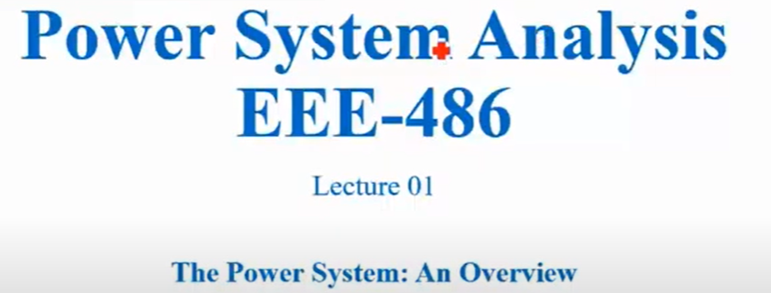

Slide 4
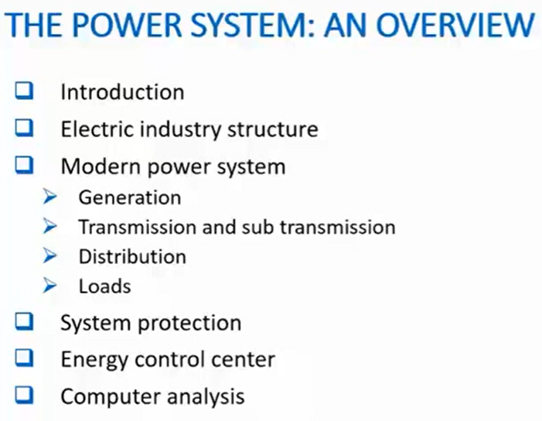

Slide 5
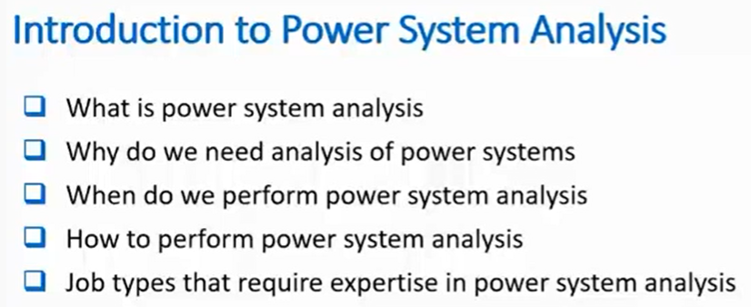

Slide 6
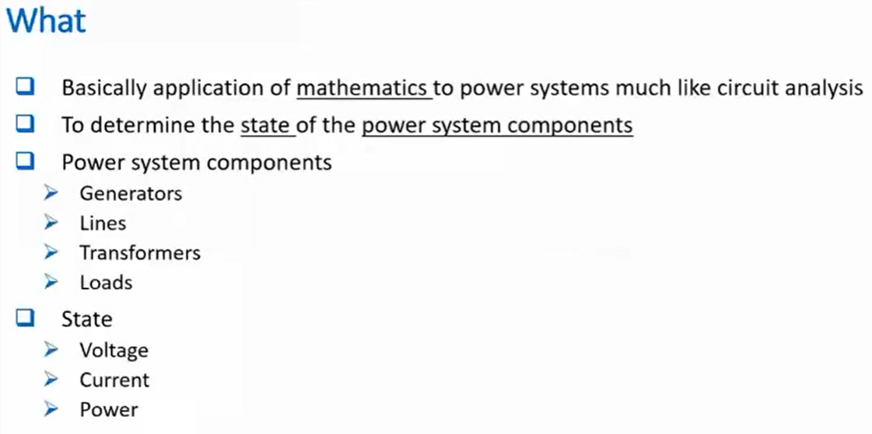

Slide 7
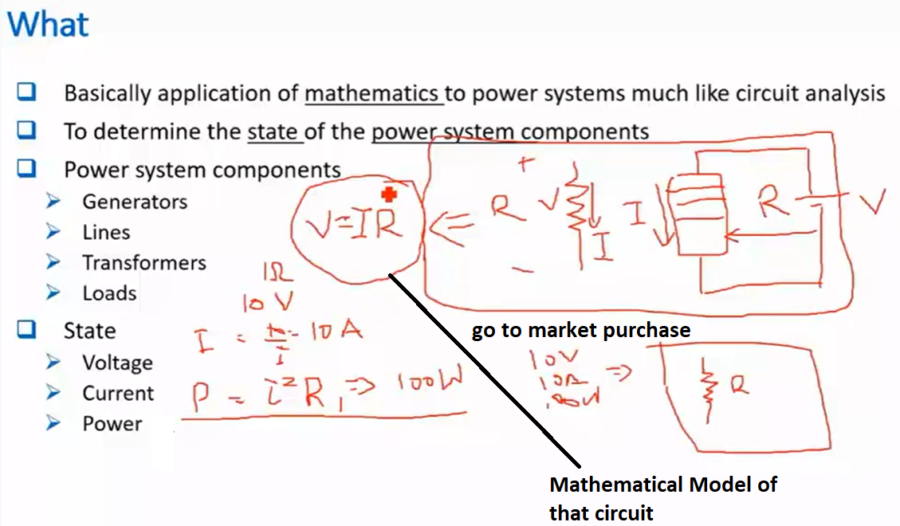

Slide 8
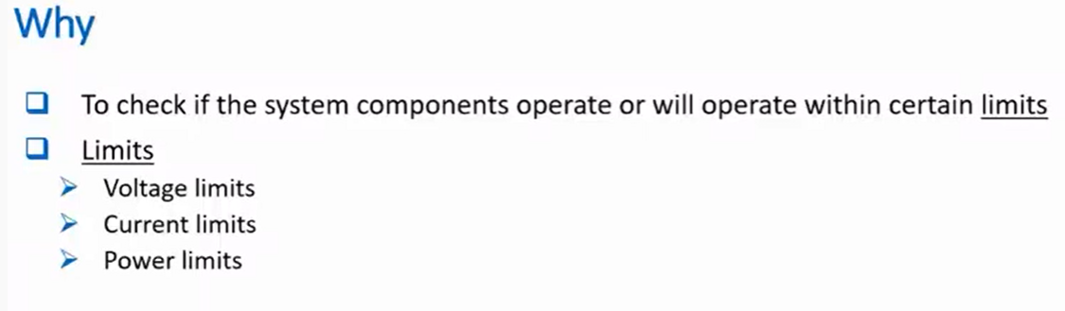

Slide 9
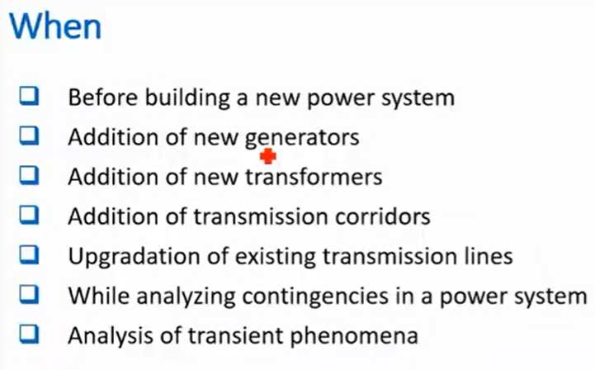

Slide 10
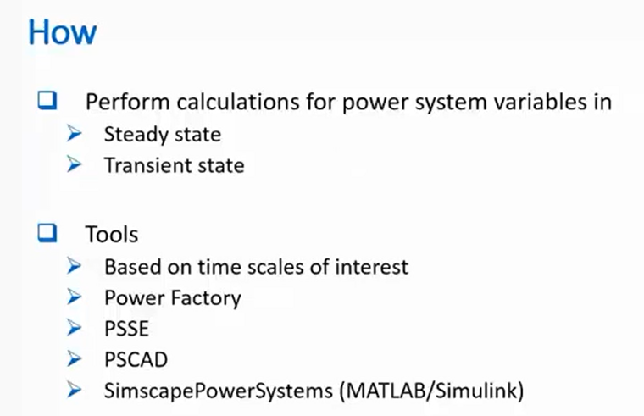

Slide 11
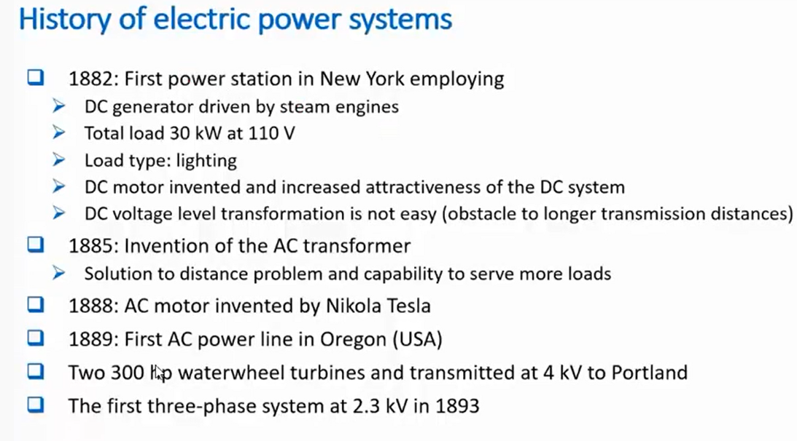

Slide 12
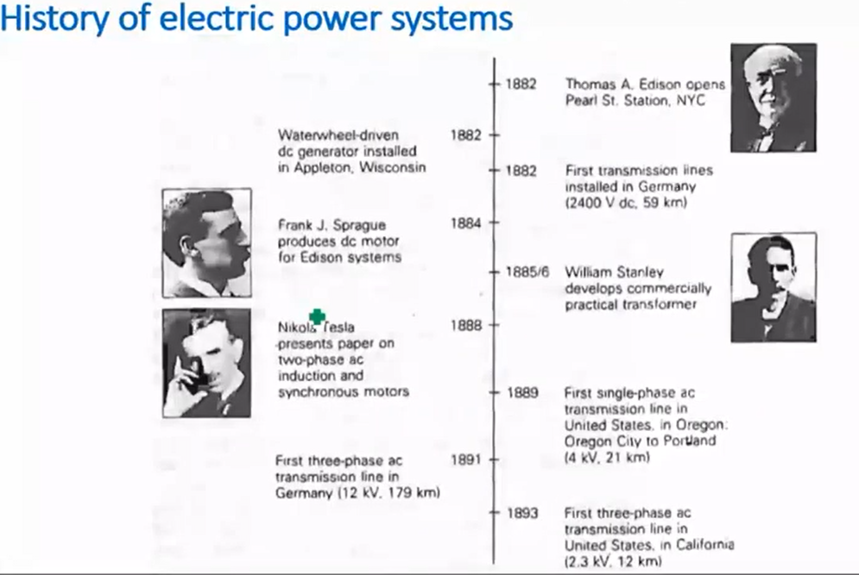

Slide 13
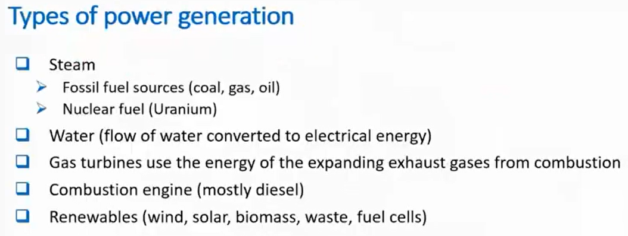

Slide 14
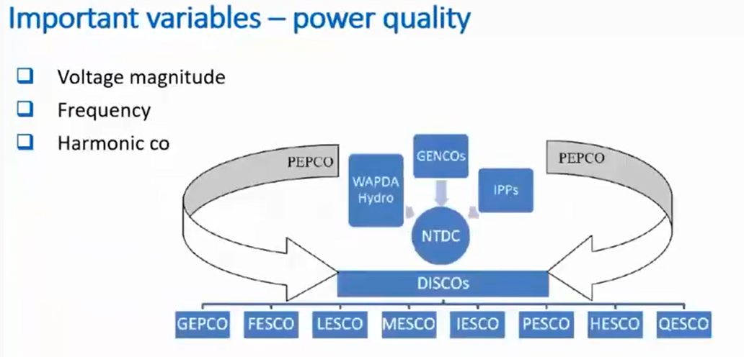

Slide 15
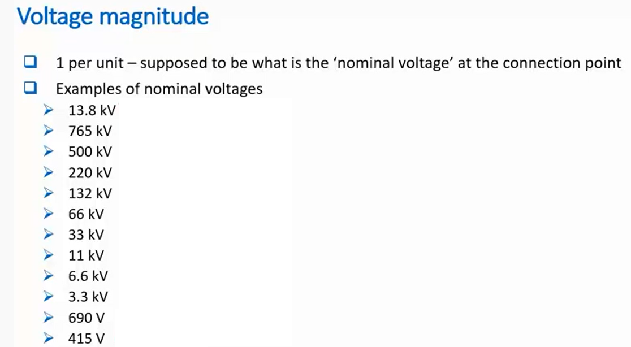

Slide 16
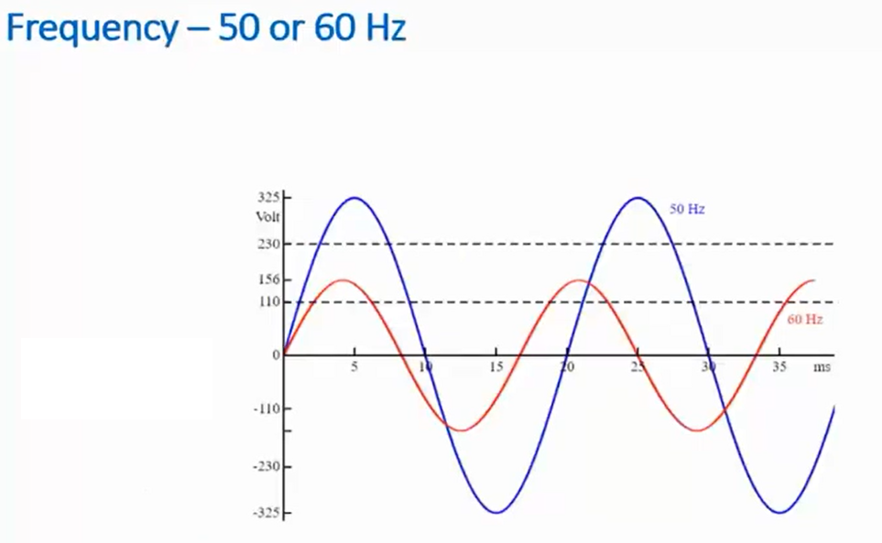

Slide 17
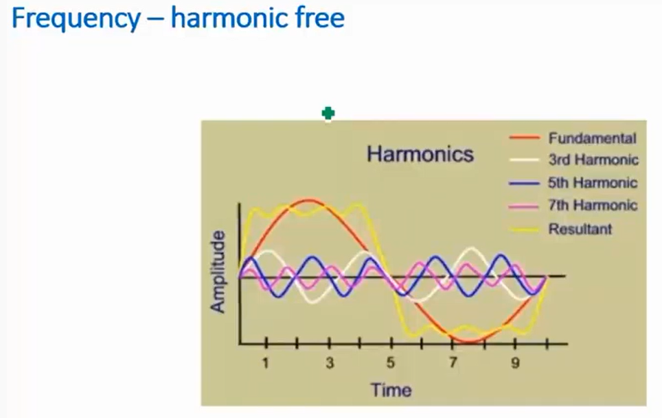

Slide 18
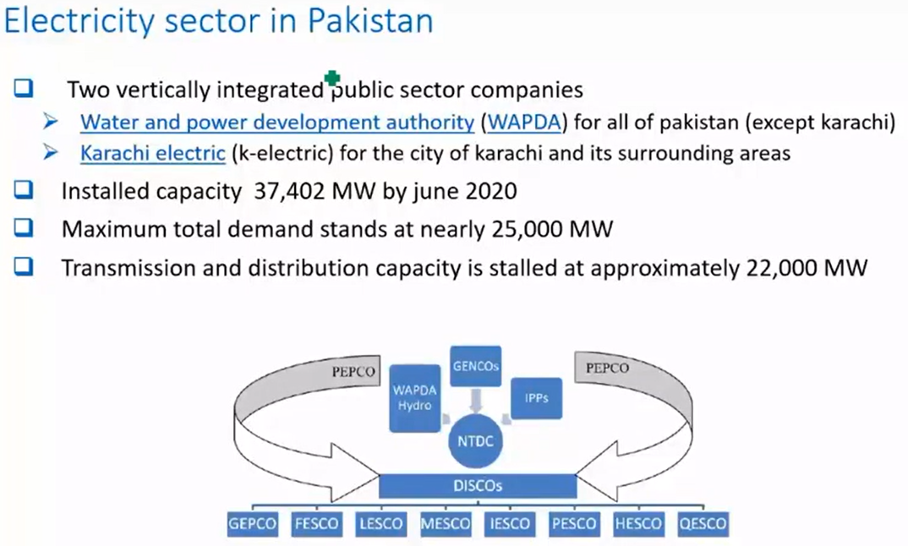

Slide 19
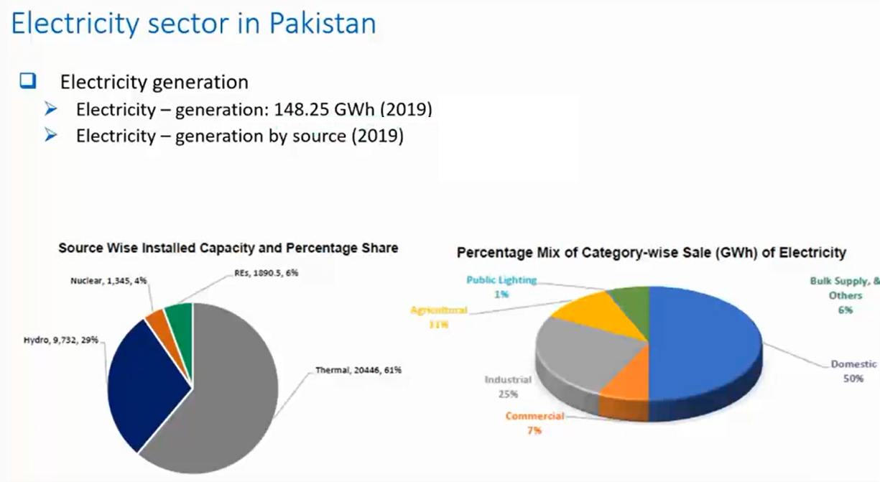

Slide 20
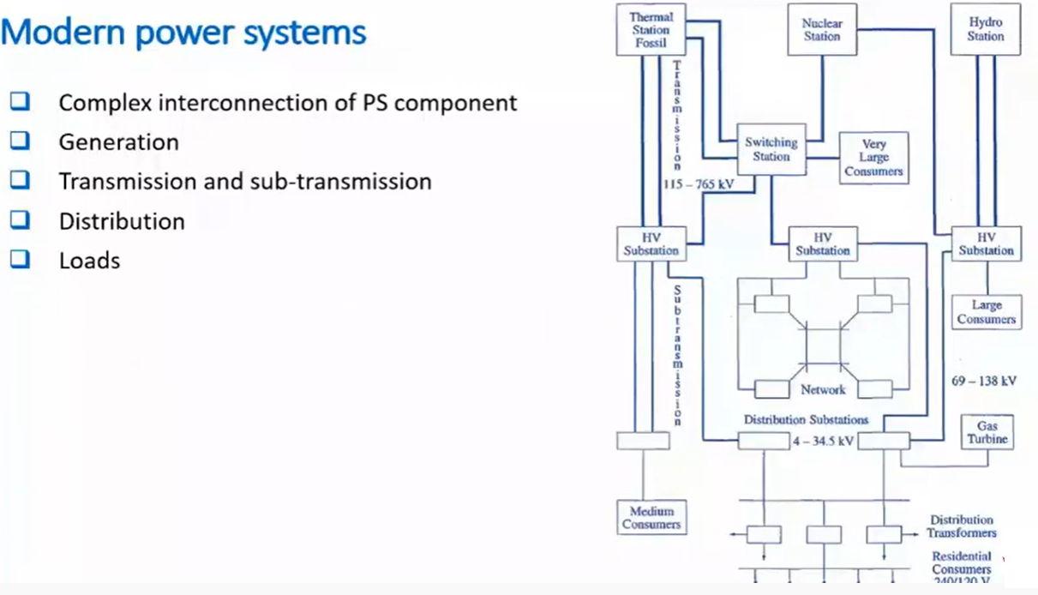

Slide 21
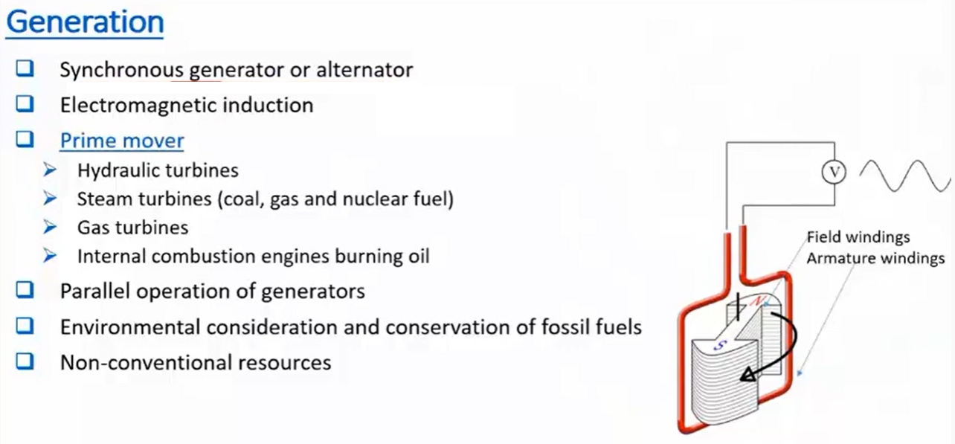

Slide 22
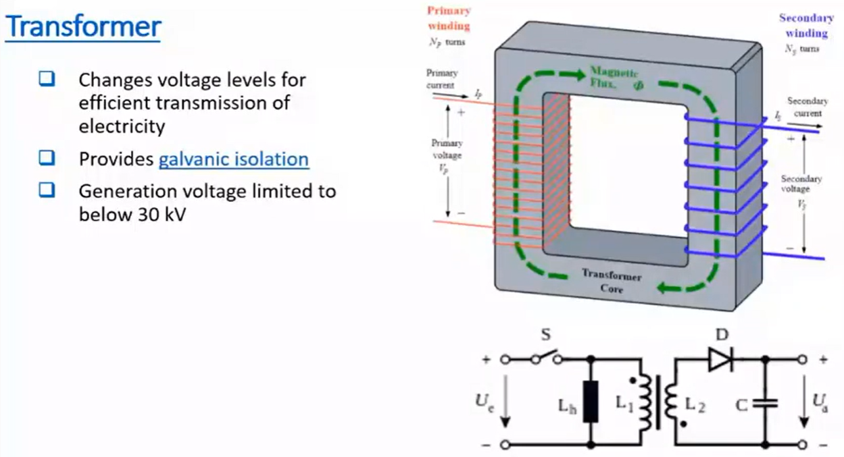

Slide 23
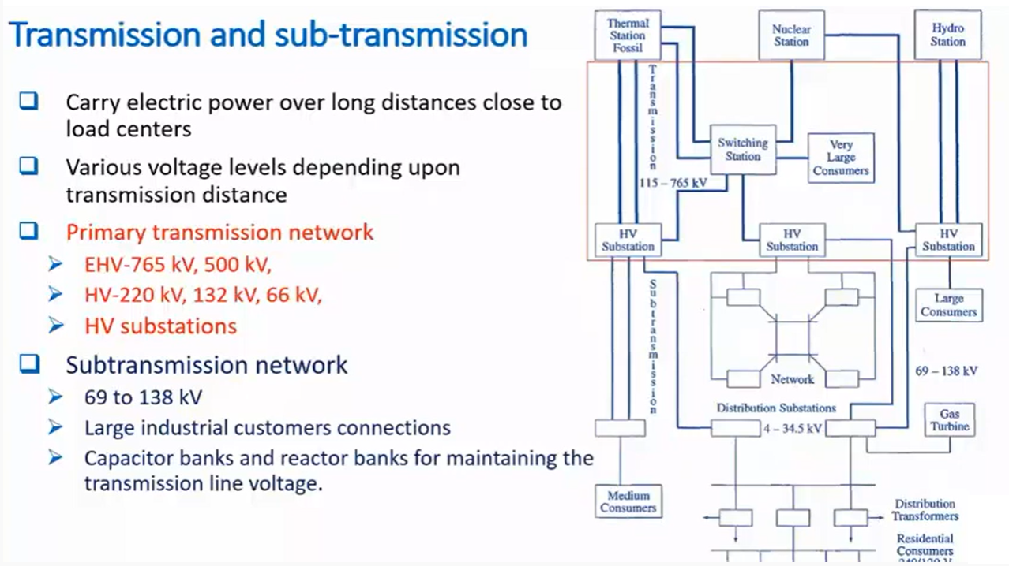

Slide 24
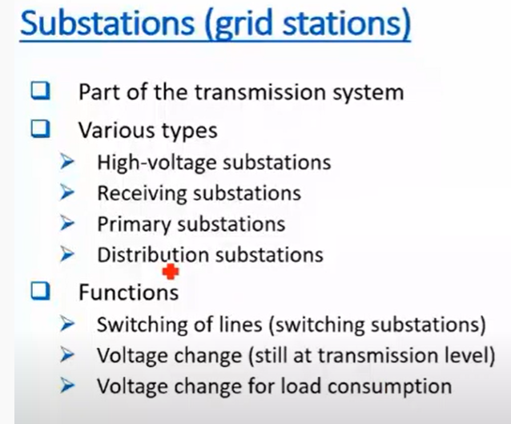

Slide 25
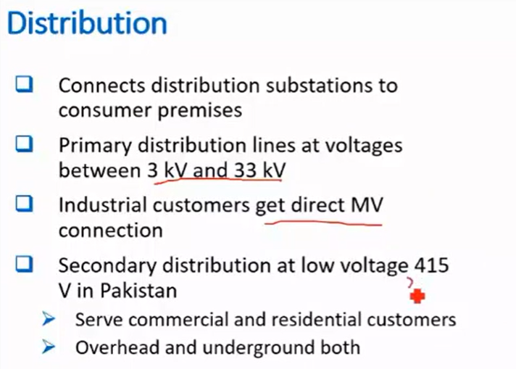

Slide 26
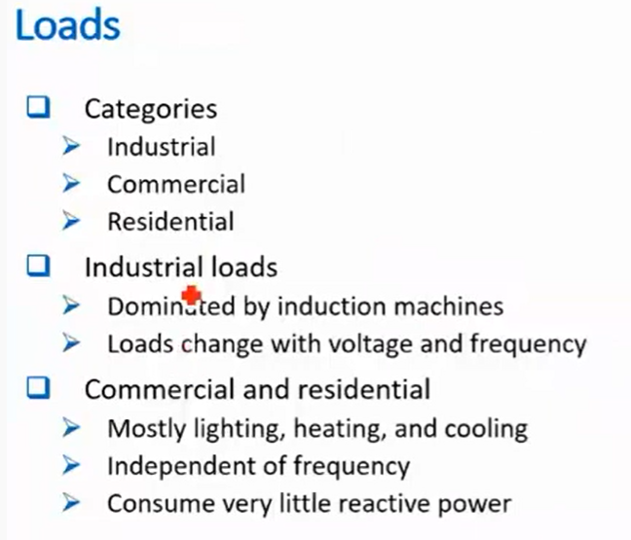

Slide 27
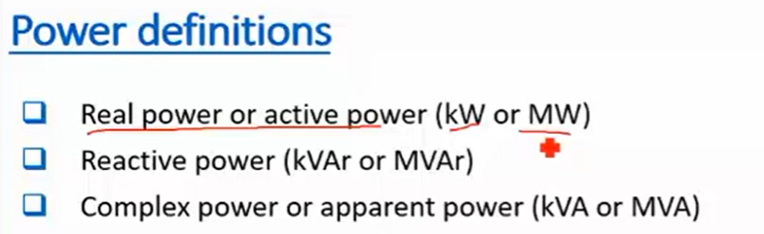

Slide 28
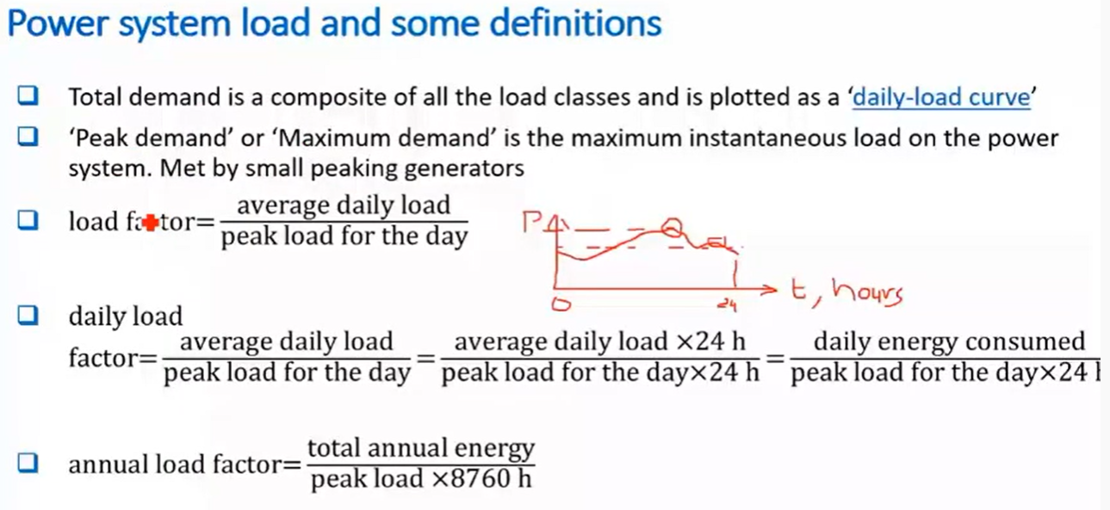

Slide 29
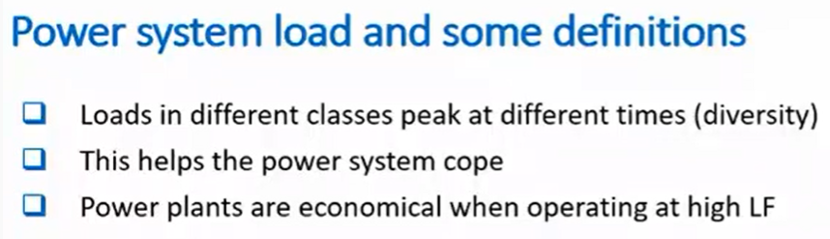
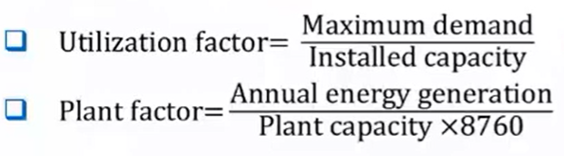

Slide 30
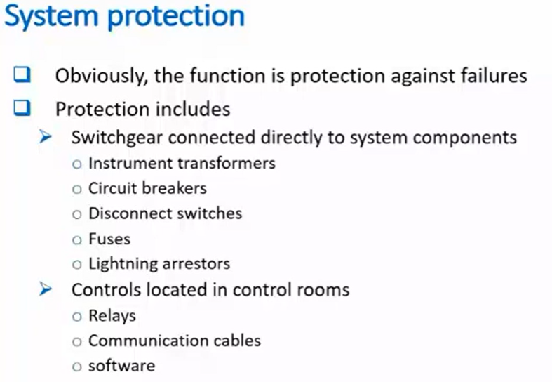

Slide 31
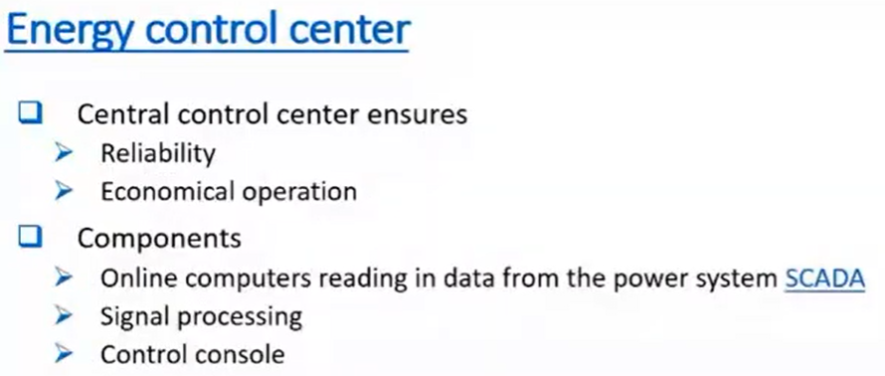

Slide 32
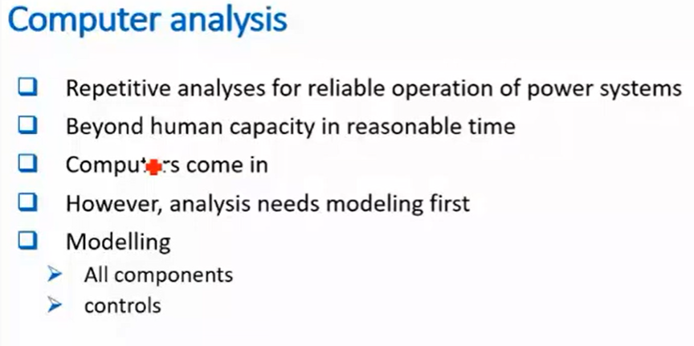

Slide 33
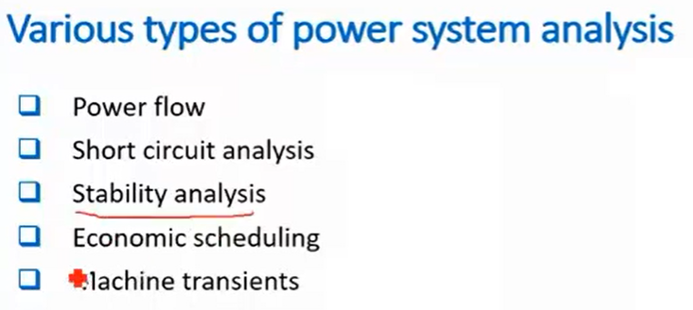

Slide 34
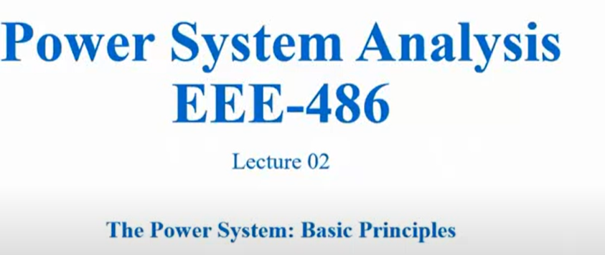

Slide 35
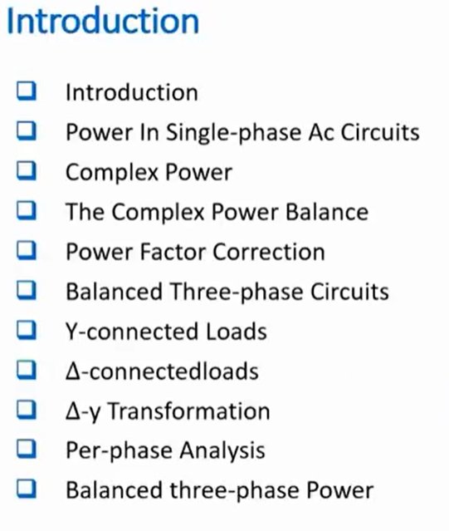

Slide 36
